Slide 1
TECH BLOG
Project Submitted BY –
Durga PRASAD Reddy
Rajat KhANDelwal
Saurav Mehare
Vaishali Mehlawat

Slide 2
ABSTRACT
Blogging is a great way to share your expertise while building a potentially valuable readership. It can help you to document projects, or provide guidance to other web users.

Slide 3
INTRODUCTION
Tech Blog is a blogging site where you can find a variety of tech information and solutions to your technical problems.
The user can view the blogs written by various authors and can also raise a query about the blogs written on the site.
The admin can login to the system and view all the blogs. They can also edit an existing blog or delete a blog if required.
The queries raised by the user will be directed to admin mail id and they can respond from there to it.

Slide 4
OUR SYSTEM
Our System is technical blog website from where user can directly view/read blog and raised a query as well .
Admin can directly add blog / delete blog / edit blog/ reply to query of user

Slide 5
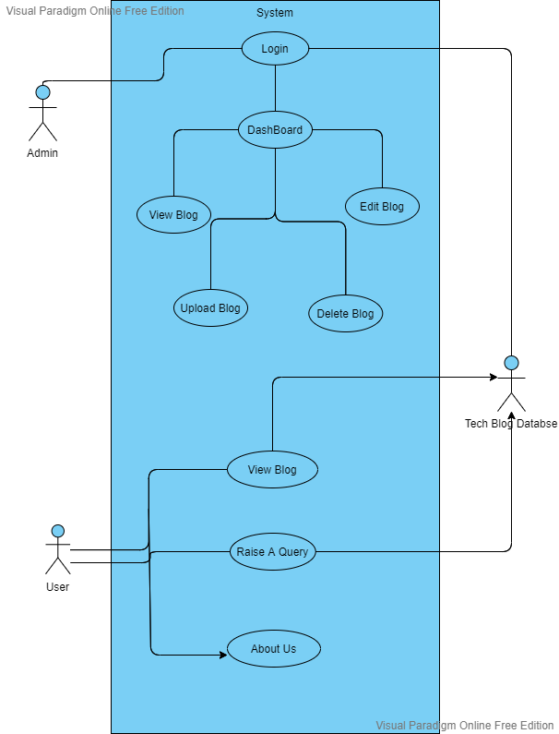
Process MoDEL

Slide 6
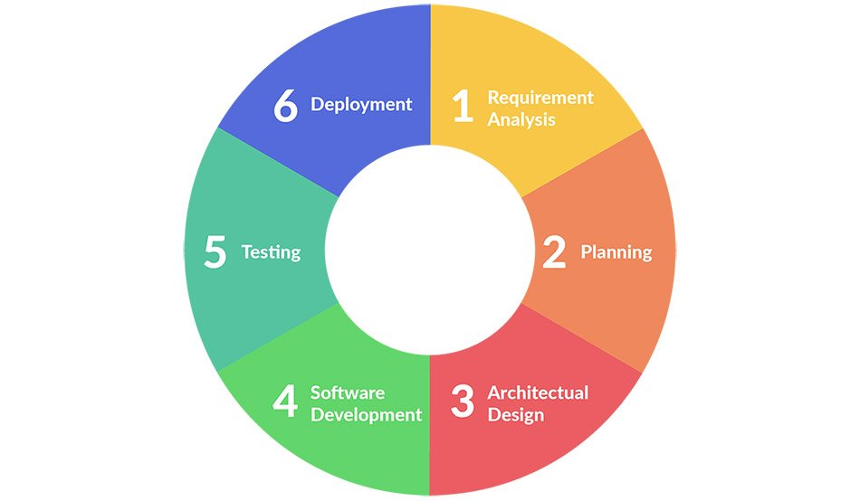
SYSTEM DEVELOPMENT LIFE CYCLE

Slide 7
Project Objective:
The key objectives to support the aims are:
The objective of the Tech Blog is to increase the point of customer choice.
Reduce time used in web surfing.

Slide 8
LANGUAGE AND TOOLS
LANGUAGE | TOOLS
HTML 5 CSS JAVA SCRIPT JAVA MySQL JSP | ECLIPSE

Slide 9
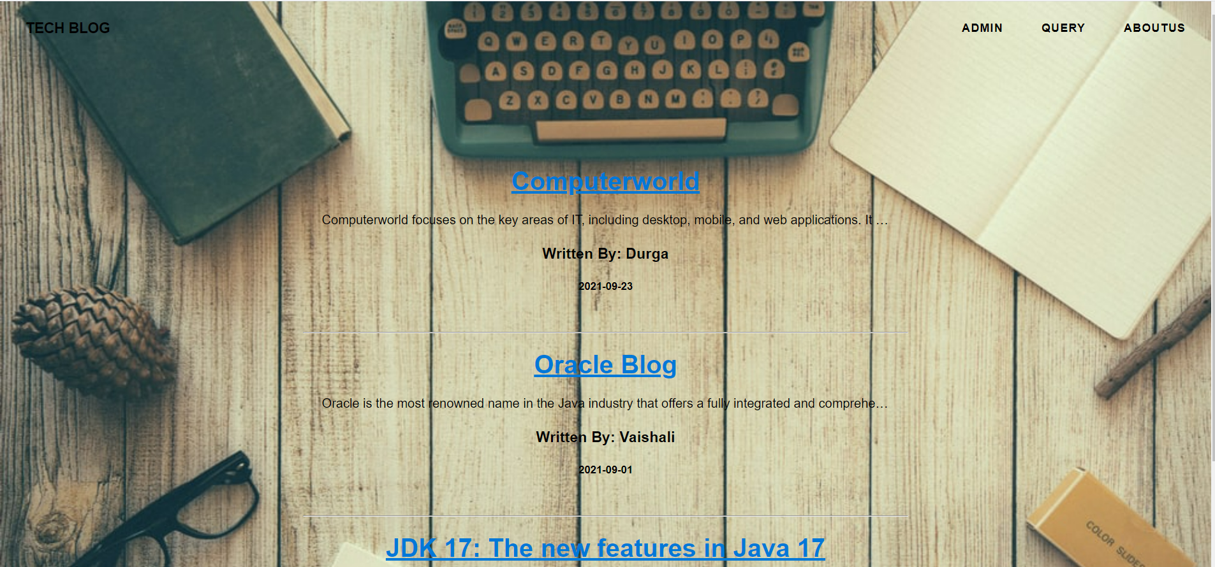
Home Page Screenshot

Slide 10

ADMIN Login screenshot

Slide 11
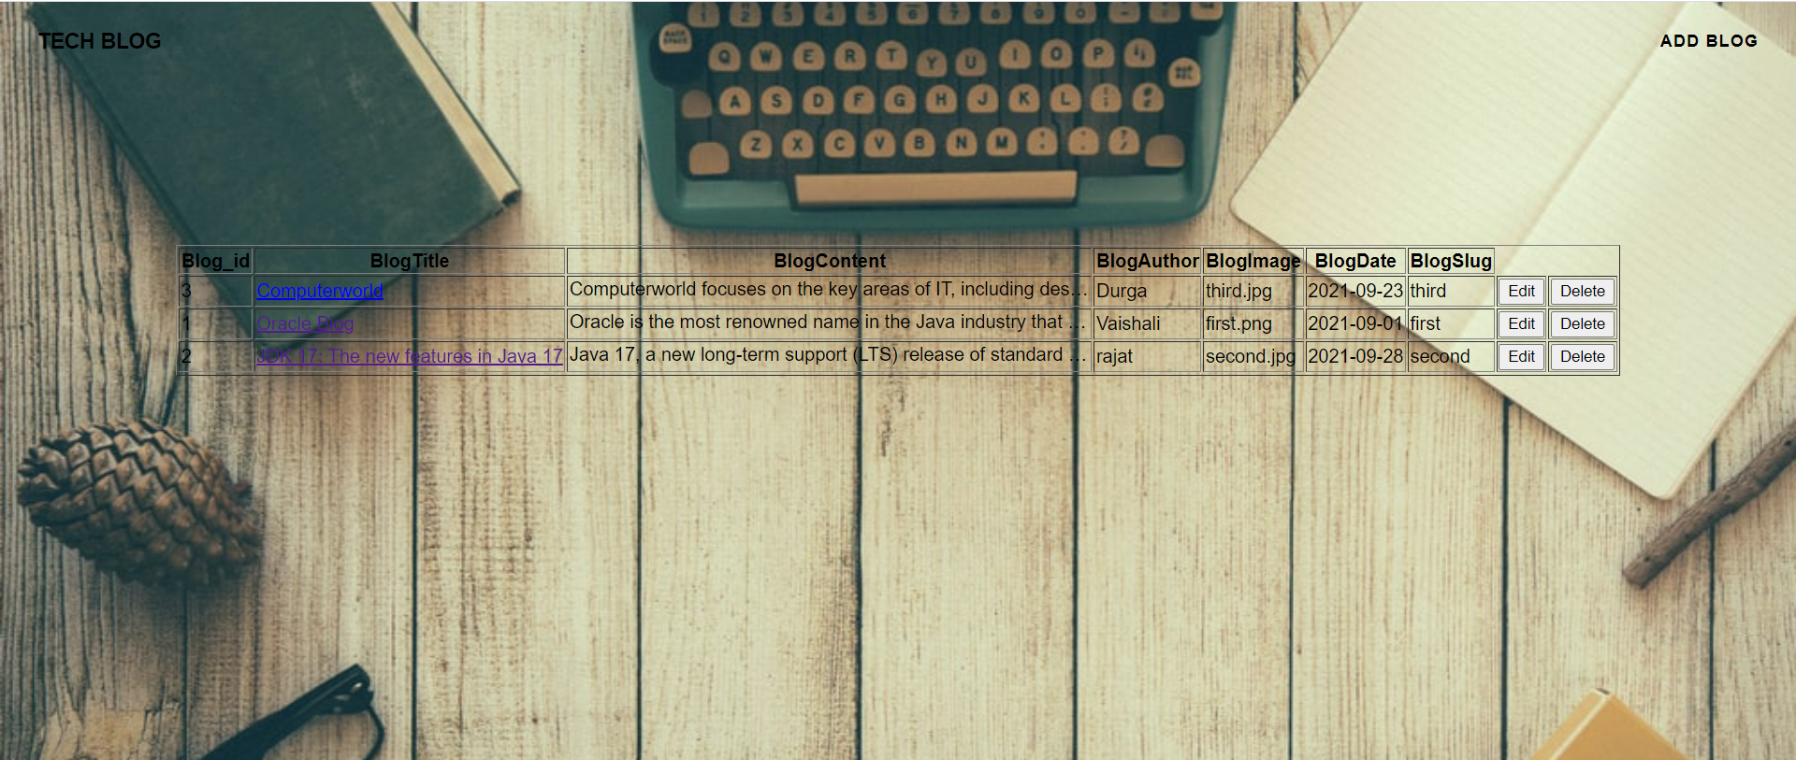
ADMIN DASHBOARD screenshot

Slide 12

query form screenshot

Slide 13
Advantages of Tech blog
You can manage your online identity and build trust.
You will learn new things.
You will connect with new people.
You can get technical knowledge.

Slide 14


Slide 15


